Slide 1
Application of Deep Learning
in Autonomous Driving System
Rui Min

Slide 2
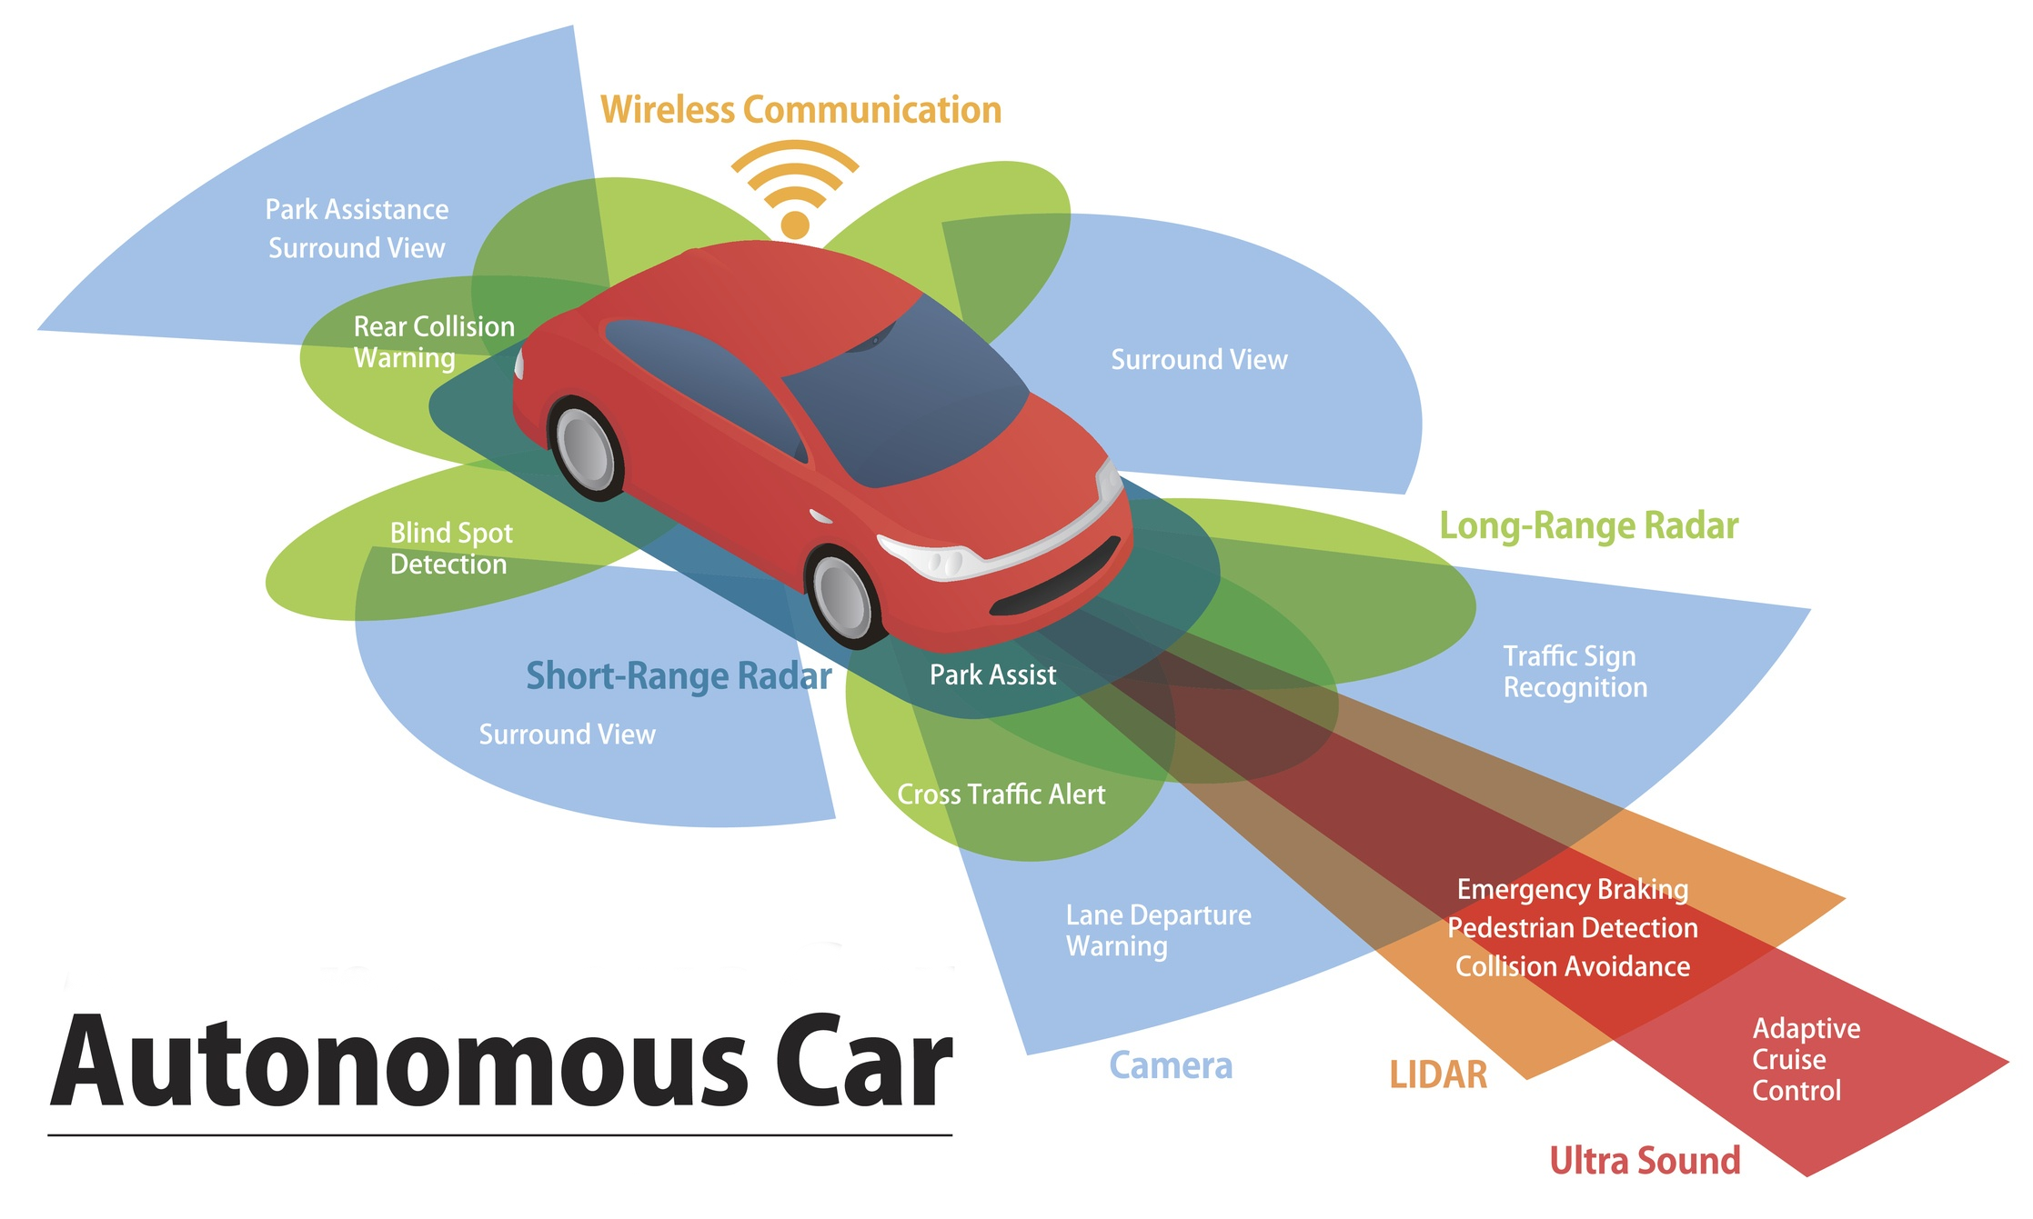
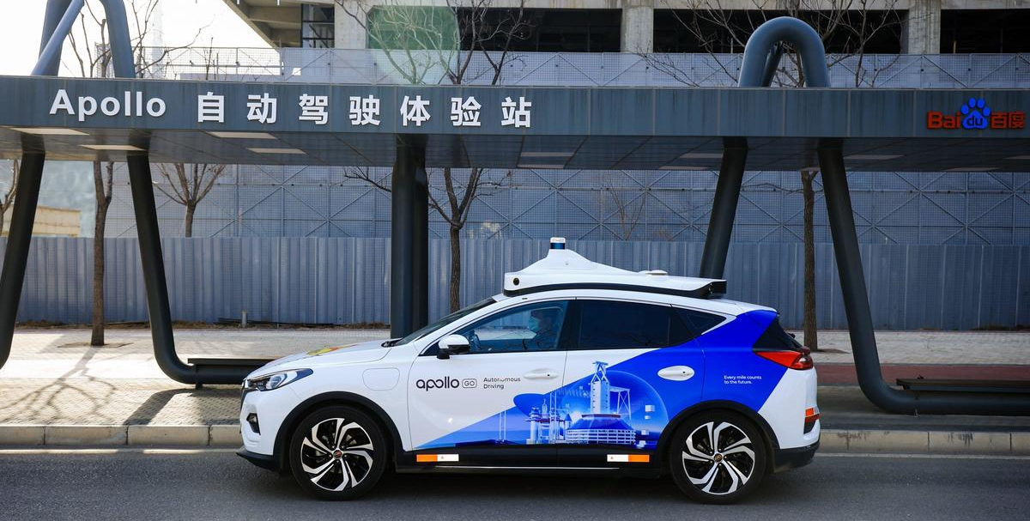
Autonomous Driving System
ADAS -> AD (Autonomous Driving) : Robotaxi
Critical factor of the AD system : Data
Sensors: Camera, Radar, LiDAR, HD Map, V2X
Baidu Apollo Robotaxi in Beijing
Picture Source: Baidu
Picture Source: Endeavor Business Media.

Slide 3
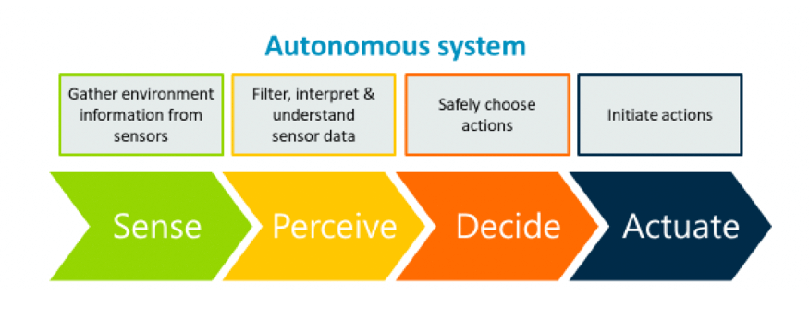
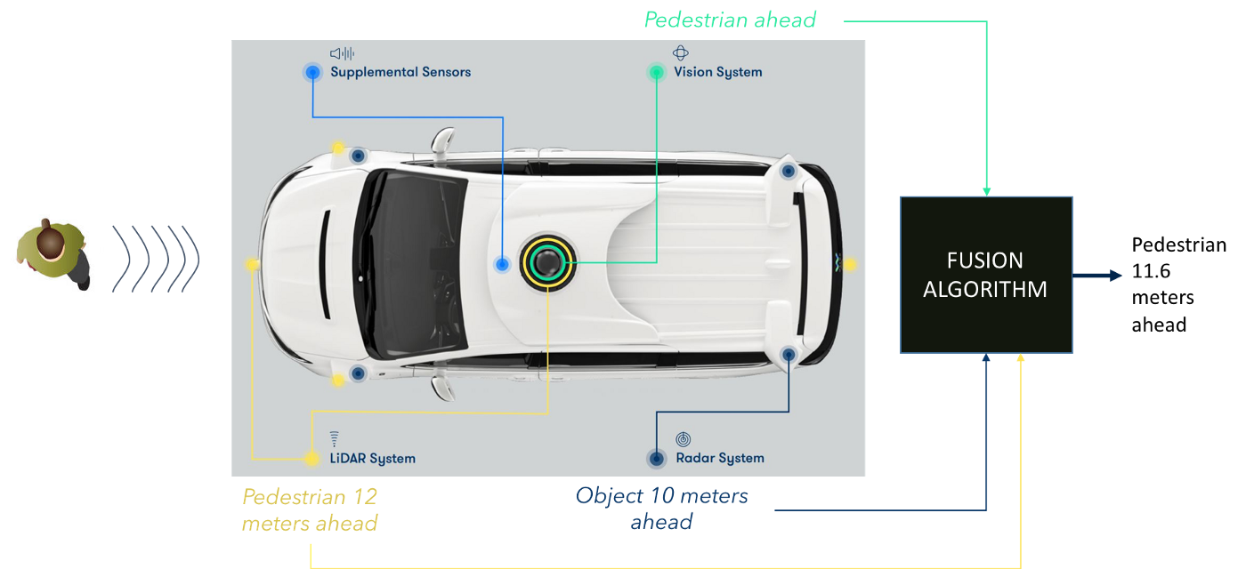
Autonomous Driving System
Composition of Autonomous System
Perception: Sense + Perceive
Decide
Actuate
Sensor Fusion
Vision + Radar + LiDAR = more accurate result
Picture Source: Arm Limited
Sensor Fusion in AD Perception
Picture Source: medium.com

Slide 4
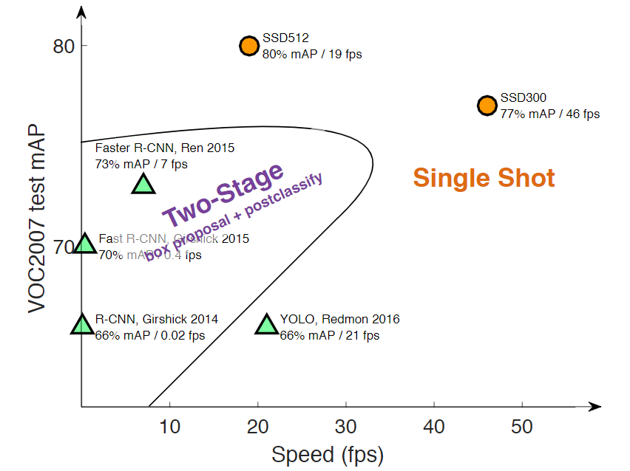
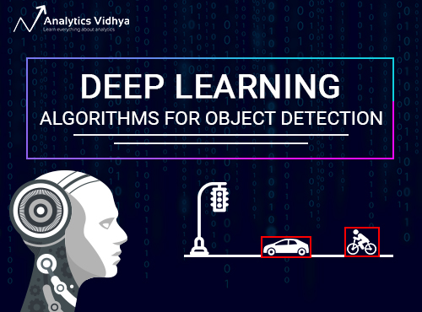
Object Detection Algorithm
Computer Vision with DL
-> Object Detection
4 components of OD framework
Region proposal
Feature extraction and network predictions
Non-maximum suppression (NMS)
Evaluation metrics
Two Stage:
R-CNN, Fast R-CNN, Faster R-CNN
One Stage:
Yolo, SSD
Picture Source: Analytics Vidhya
Picture Source: SSD: Single Shot MultiBox Detector (slides)

Slide 5
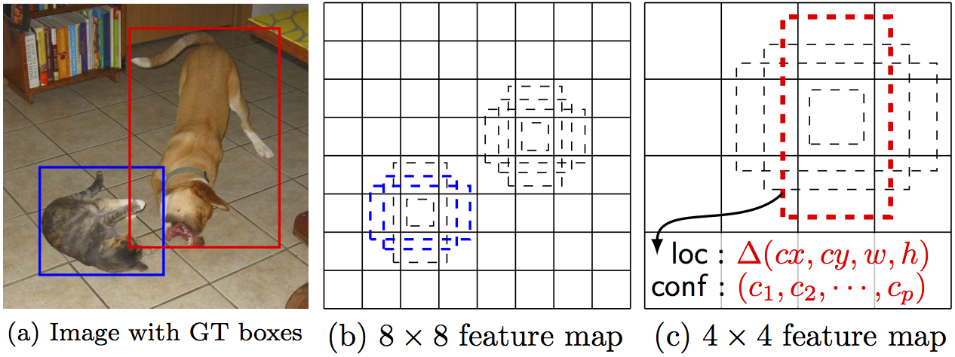
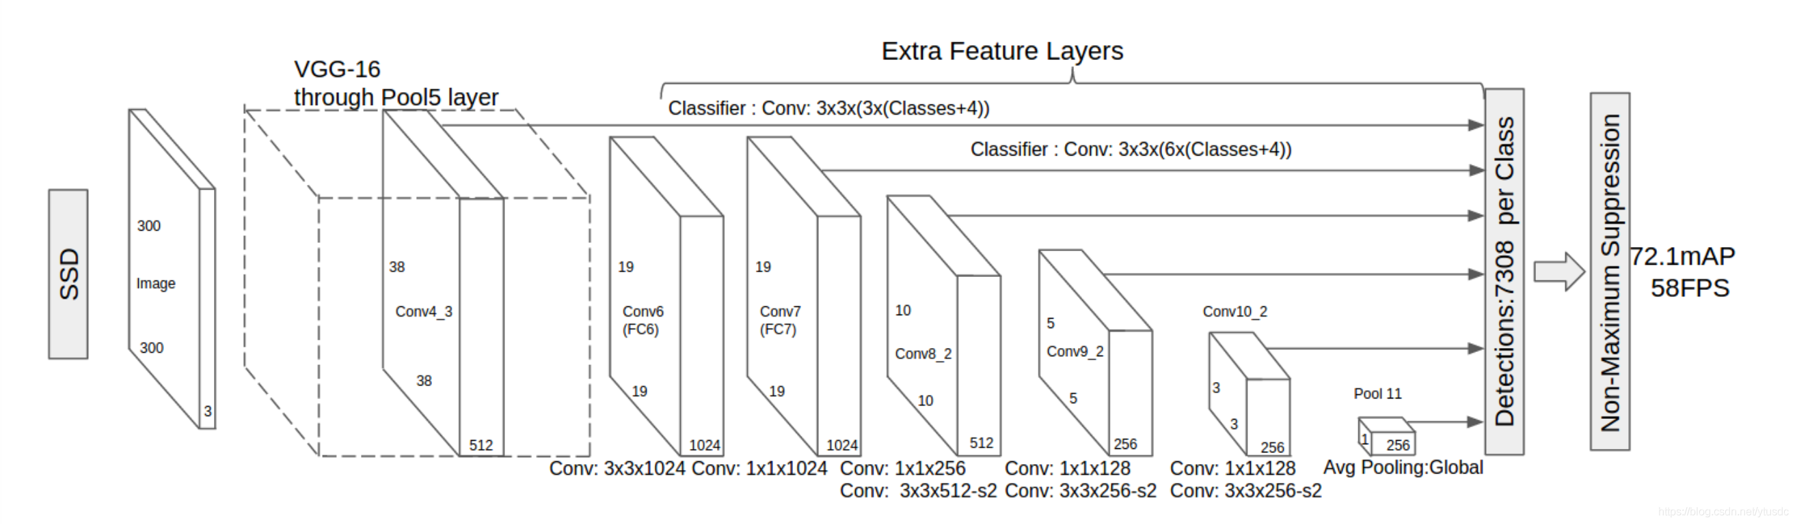
SSD: Single Shot MultiBox Detector
Good balance between speed and accuracy
Prior Box (Anchor Box)
Feature maps of various scales
Hard Negative Mining
Source: SSD: Single Shot MultiBox Detector

Slide 6
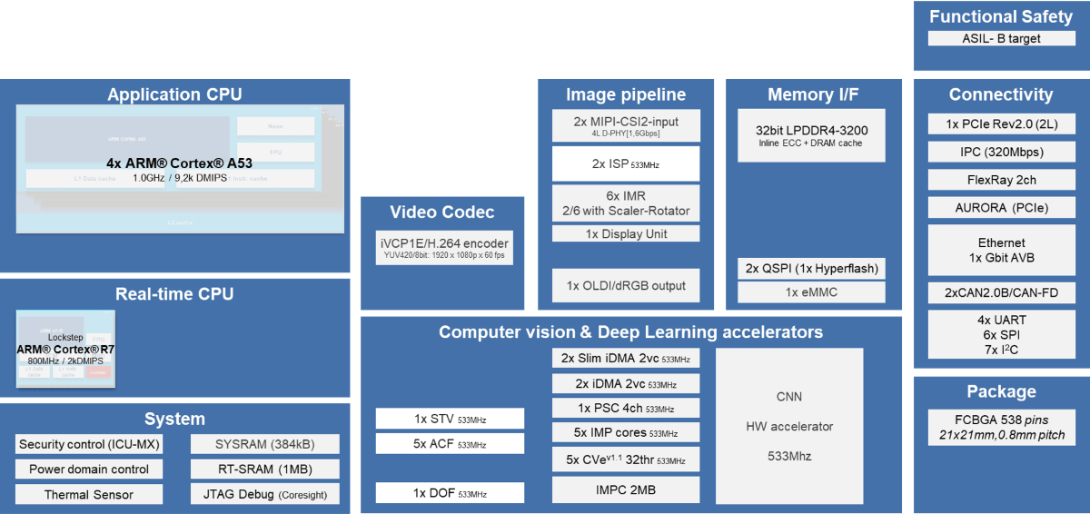
Implementation on Embedded platform
Pre-trained SSD model
Convert model to Renesas V3H (eCube)
Implement real-time image processing
Renesas R-Car V3H Block Diagram
Frontend CNN Toolchain
(Renesas)
Pre-trained SSD Model (Caffe)
Picture Source: Renesas

Slide 7
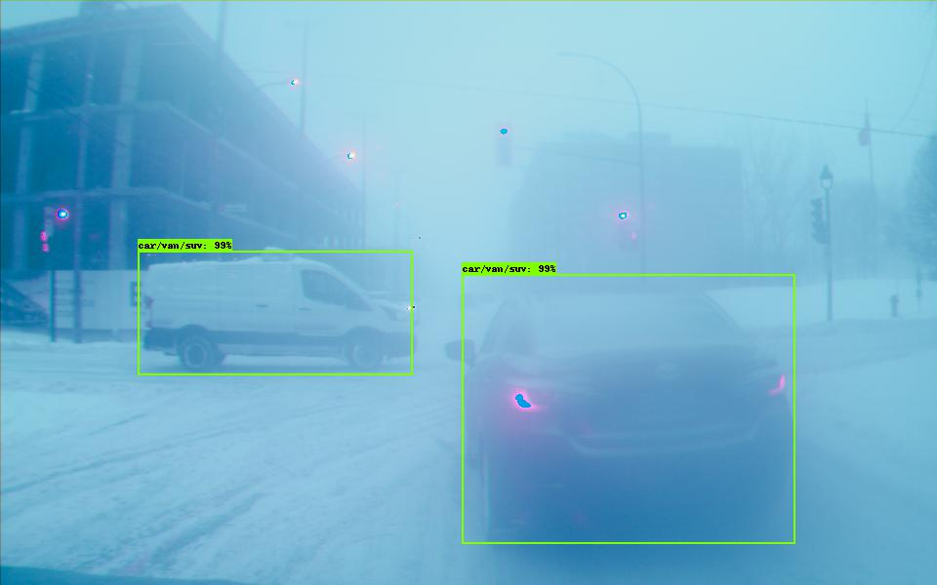
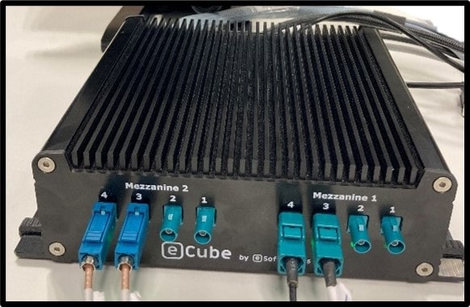
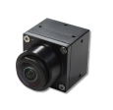
Implementation on Embedded platform
Pre-trained SSD model
Convert model to Renesas V3H (eCube)
Implement real-time image processing

Slide 8

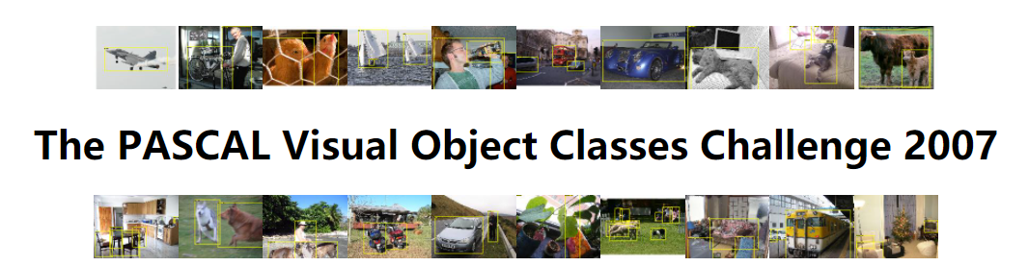
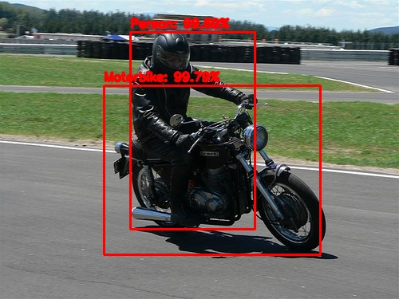
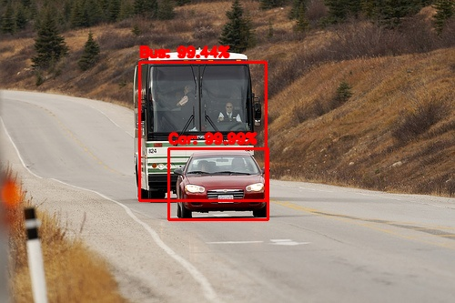
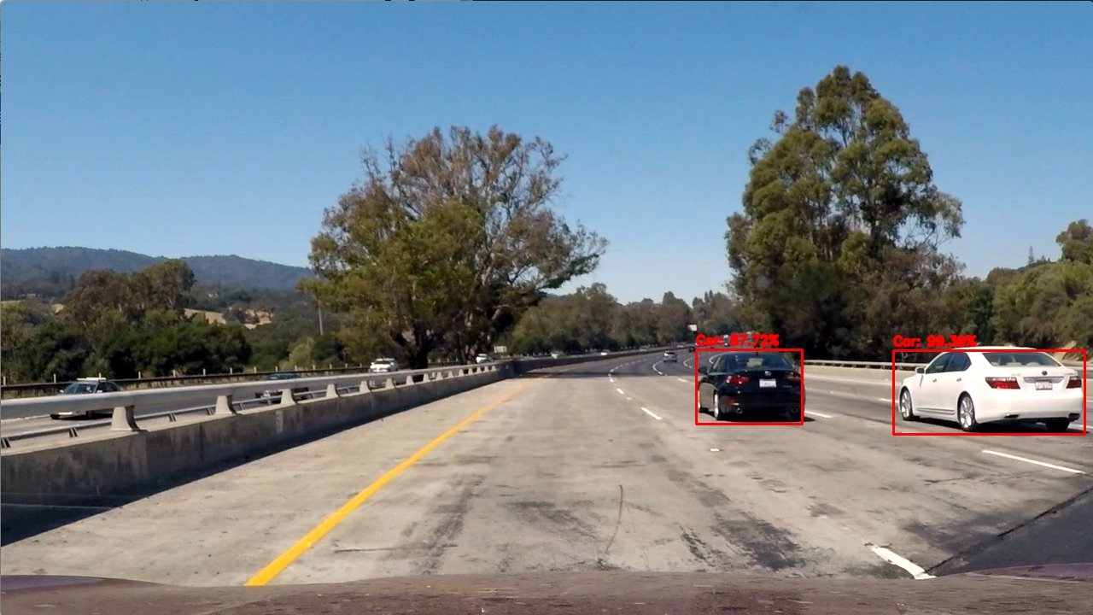
Project Demo
My implementation based on pre-trained model.
Testing on the dataset VOC2007
Detect on the classes of
Bicycle, Bus, Car, Motorbike, Person, Train

